Slide 1
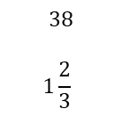
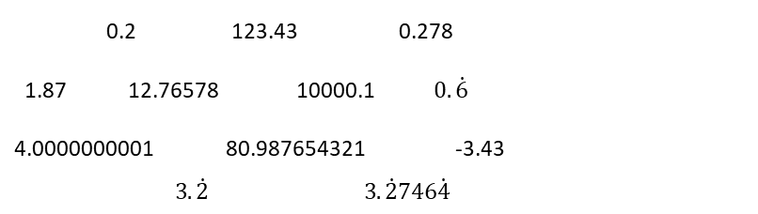
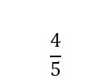
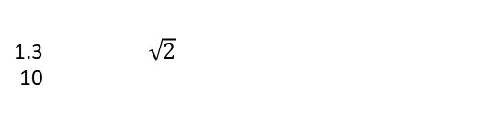
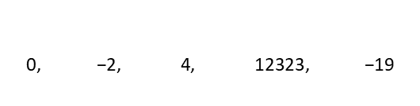

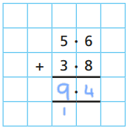
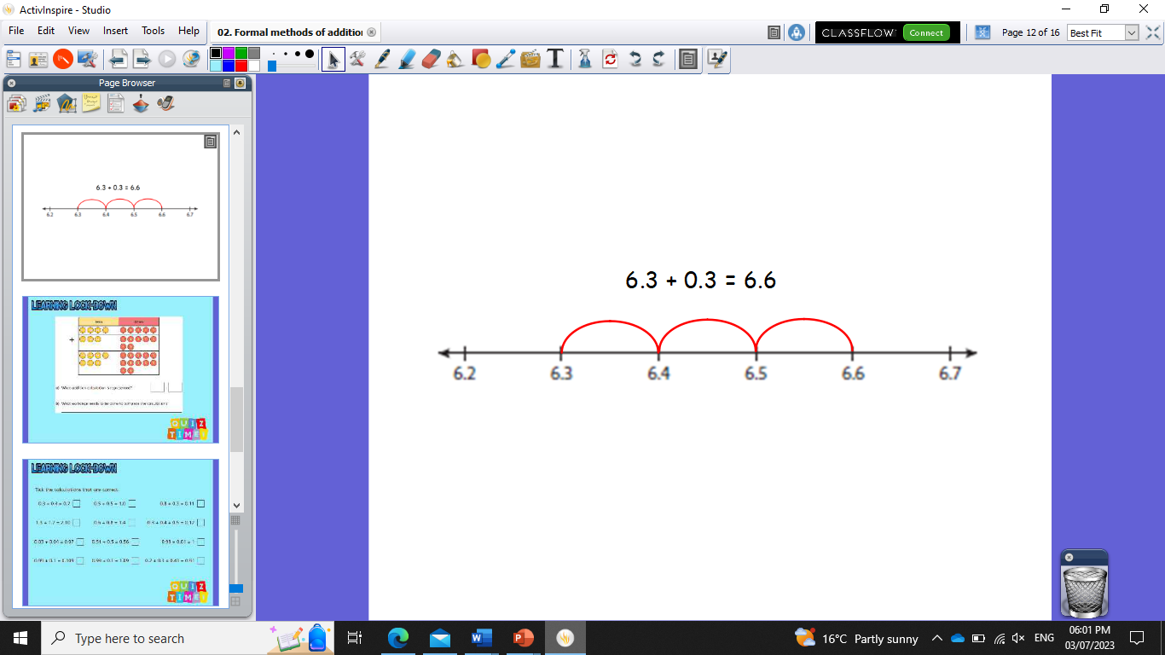
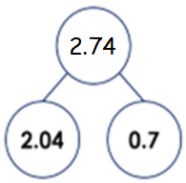
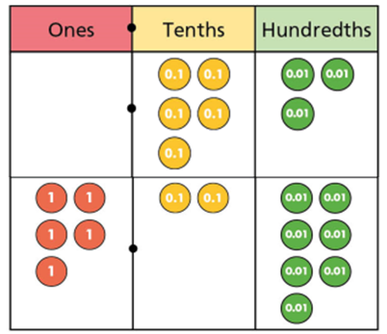
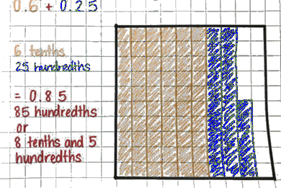
Subtopic N2.5 – Use Formal Methods for Addition of Decimals
LEARNING OUTCOME: To be able to use formal methods to add decimals
Keywords:
Addition
Decimals
Column
Exchange
Objectives:
To add decimals without exchanging
To add decimals with exchanging
To solve worded problems involving adding decimals
Introduction – Read and annotate:
When adding decimals, it is important to line up the decimal points so that digits with the same place
value (ones, tenths, hundredths, etc.) are correctly aligned. This ensures that each digit is added to
the correct corresponding digit. You may also add zeros as placeholders to make the numbers the
same length, which makes it easier to line up and add each column correctly.
Definition
Characteristics
A decimal is a number that is not whole, as it lies between whole numbers.
Consists of a whole and a fraction part.
The fractional part is written as digits after a point rather than a fraction.
The whole and fraction parts are separated by a point called the decimal point.
Can be terminating or recurring.
Examples
Decimal
Non - Examples
240
Adding decimals can be represented in many ways:
11.8 + 2.3 = 14.1
2.04 + 0.7 = 2.74
0.53 + 5.27 = 5.80

Slide 2
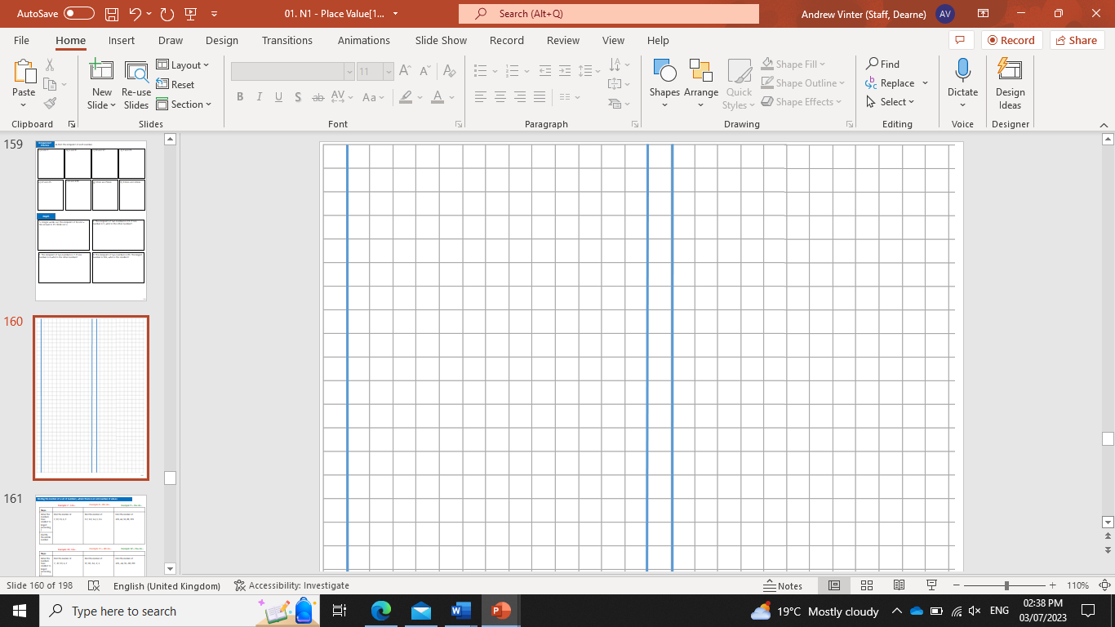
Add decimals with no exchanging (tenths only)
Example 1 - I do…
Example 2 – We do…
Example 3 – You do…
Steps | Calculate | Calculate | Calculate
Set up the addition with the decimal place aligned vertically. | 3.2 + 1.4 | 2.1 + 0.5 | 1.2 + 2.7
Add the digits in each column.
4.6
2.6
3.9
Independent Practice
1. Calculate the following:
a)
1.6 + 1.2
b)
3.4 + 1.3
c)
6.7 + 2.1
2.8
4.7
8.8
d)
6.2 + 0.7
e)
0.8 + 3.1
f)
12.2 + 10.3
6.9
3.9
22.5
g)
31.2 + 3.4
h)
73.2 + 16.6
i)
114.7 + 54.2
34.6
89.8
168.9

Slide 3
Add decimals with no exchanging (hundredths only)
Example 4 - I do…
Example 5 – We do…
Example 6 – You do…
Steps | Calculate | Calculate | Calculate
Set up the addition with the decimal place aligned vertically. | 1.91 + 3.07 | 2.56 + 1.32 | 7.81 + 1.07
Add the digits in each column.
4.98
3.88
8.88
Independent Practice
2. Calculate the following:
a)
2.76 + 1.21
b)
0.15 + 2.31
c)
5.23 + 3.65
3.97
2.46
8.88
d)
4.82 + 2.17
e)
12.16 + 13.21
f)
21.72 + 12.15
6.99
25.37
33.87
g)
17.13 + 2.72
h)
3.18 + 54.21
i)
123.12 + 54.23
19.85
57.39
177.35

Slide 4
Add decimals with no exchanging (tenths and hundredths mixed)
Example 7 - I do…
Example 8 – We do…
Example 9 – You do…
Steps | Calculate | Calculate | Calculate
Set up the addition with the decimal place aligned vertically. | 0.25 + 1.3 | 6.1 + 1.24 | 7.36 + 1.4
Add the digits in each column.
1.55
7.34
8.76
Independent Practice
3. Calculate the following:
a)
2.7 + 1.21
b)
0.16 + 2.3
c)
1.2 + 2.65
3.91
2.46
3.85
d)
7.8 + 2.07
e)
2.7 + 1.15
f)
8.4 + 1.52
9.87
3.85
9.92
g)
3.51 + 2.3
h)
12.1 + 14.26
i)
42.1 + 14.23
5.81
26.36
56.33

Slide 5
Add decimals with exchanging (tenths only or hundredths only)
Example 10 - I do…
Example 11 – We do…
Example 12 – You do…
Steps | Calculate | Calculate | Calculate
Set up the addition with the decimal place aligned vertically. | 9.7 + 3.5 | 18.45 + 14.72 | 2.7 + 3.4
Add the digits in each column.
13.2
33.17
6.1
Independent Practice
4. Calculate the following:
a)
4.8 + 3.7
b)
2.3 + 7.8
c)
6.8 + 4.6
8.5
10.1
11.4
d)
4.75 + 8.48
e)
12.53 + 35.78
f)
51.28 + 32.43
13.23
48.31
83.71
g)
125.5 + 456.7
h)
346.51 + 52.64
i)
23.6 + 258.5
582.2
399.15
282.1

Slide 6
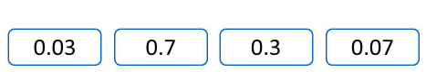
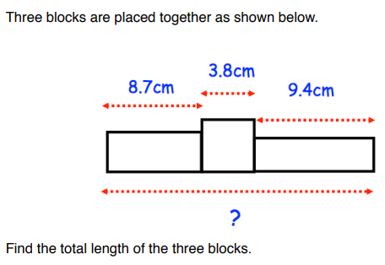

5. Which two number cards add together to make 0.37?
Three blocks are placed together as shown. Find the total length of the three blocks.
21.9
7.
20.25 + 5.25 + 18.36 + 6.14
3.67 + 45.15 + 0.01 + 1.17 etc.

Slide 7
Add any pair of decimals including exchanging
Example 13 - I do…
Example 14 – We do…
Example 15 – You do…
Steps | Calculate | Calculate | Calculate
Set up the addition with the decimal place aligned vertically. | 121.9 + 19.25 | 45.87 + 3.8 | 23.4 + 94.56
Add the digits in each column.
141.15
49.67
117.96
Independent Practice
8. Calculate the following:
a)
19.76 + 7.5
b)
76.4 + 6.27
c)
2.38 + 65.9
27.26
82.67
68.28
d)
8.92 + 38.9
e)
82.58 + 1.8
f)
145.3 + 89.45
47.82
84.38
234.75
g)
83.4 + 185.32
h)
62.3 + 82.68
i)
1452.3 + 78.25
268.72
144.98
1530.55

Slide 8
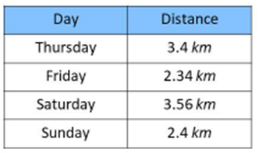
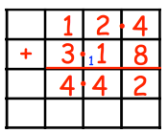
9. Hannah cycles each day.
i) What is the total distance she travels at the weekend?
ii) What is the total distance travelled across all four days?
5.96
11.7
10. Grace is working out 12.4 + 3.18 Can you spot any mistakes?
The columns are lined up incorrectly.
11. Write the following with a >, < or = symbol to make the statements correct. 14.5 + 26.8 23.4 + 17.9 58.5 + 3.45 32.87 + 28.3
=
›

Slide 9
Add a decimal and a whole number together
Example 16 - I do…
Example 17 – We do…
Example 18 – You do…
Steps | Calculate | Calculate | Calculate
Set up the addition with the decimal place aligned vertically. | 16 + 4.2 | 29.23 + 17 | 71.2 + 15
Add the digits in each column.
20.2
46.23
86.2
Independent Practice
12. Calculate the following:
a)
82 + 4.5
b)
67 + 0.7
c)
52 + 1.3
86.5
67.7
53.3
d)
15 + 73.4
e)
62.5 + 58
f)
7 + 84.67
88.4
120.5
91.67
g)
9 + 103.4
h)
73.56 + 187
i)
203 + 278.6
112.4
260.56
481.6

Slide 10
Worded problems with addition of decimals
Example 19 - I do…
Example 20 – We do…
Example 21 – You do…
Steps
Set up the addition with the decimal place aligned vertically. | A factory uses 14.36 kg of flour and 8.9 kg of sugar for its cake mixture. What is the total quantity of flour and sugar used? | Holly travels 2.5 miles to school. Carol travels 1.8 miles further to school than Holly. How far does Carol travel to school? | Jasmine travels for 56.3 km stops then continues her journey for another 12.6 km to reach her destination. How far has she travelled in total?
Add the digits in each column.
23.26
4.3
68.9
Independent Practice
13. Calculate the following:
a)
David drives 4.8 miles to Bristol and a further 6.7 miles to Bath. Work out how far he drives in total.
b)
Mr Jenkins has two pieces of rope. The pieces of rope are 2.35m and 1.8m long. Work out the total length of the pieces of rope.
c)
Two pieces of ribbon are 23.4cm long and the other 45.34cm long. How much ribbon is there altogether?
11.5
4.15
68.74
d)
Mo completes his first marathon in 2.3 hours and a second marathon in a time of 2.25 hours. What is his total time across both runs?
e)
A triangle has side lengths of 5.4mm, 6.7mm and 10.2mm. What is the total length of the sides?
Heena can run 100m in 18.53 seconds. She can swim 100m in 30.6 seconds. What is Heena’s total time running and swimming?
f)
4.55
22.3
49.13
14. Work out:
Thirty-two point five + four tenths and three hundredths.
32.93
‹#›

